Slide 1

Macroeconomics
Sixth Canadian Edition
Chapter 4
Consumer and Firm Behaviour: The Work-Leisure Decision and Profit Maximization
Copyright © 2021 Pearson Canada Inc.
Notes:
If this PowerPoint presentation contains mathematical equations, you may need to check that your computer has the following installed:
1) MathType Plugin
2) Math Player (free versions available)
3) NVDA Reader (free versions available)

Slide 2
Chapter 4 Topics
Behaviour of the representative consumer
Behaviour of the representative firm

Slide 3
Representative Consumer
Consumer’s preferences over consumption and leisure as represented by indifference curves.
Consumer’s budget constraint.
Consumer’s optimization problem: making himself or herself as well off as possible given his or her budget constraint.
How does the consumer respond to: (i) an increase in non-wage income; (ii) an increase in the market real wage rate?

Slide 4
Representative Consumer’s Indifference Curves
An indifference curve slopes downward (more is preferred to less).
An indifference curve is convex (the consumer has a preference for diversity in his or her consumption bundle).

Slide 5
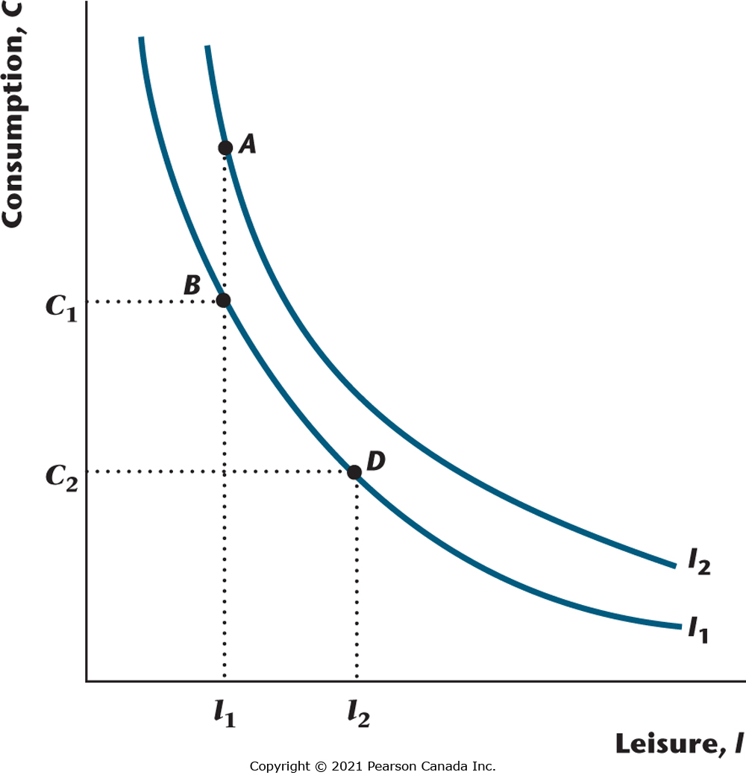
Figure 4.1 Indifference Curves
The figure shows two indifference curves for the consumer. Each indifference curve represents a set of consumption bundles among which the consumer is indifferent. Higher indifference curves represent higher welfare for the consumer.

Slide 6
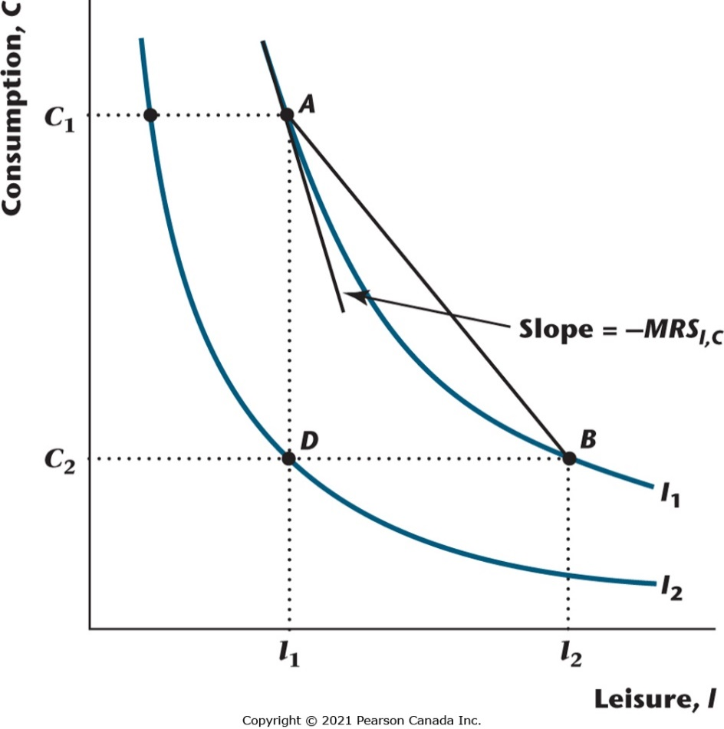
Figure 4.2 Properties of Indifference Curves
Indifference curves are downward-sloping because more is preferred to less. A preference for diversity implies that indifference curves are convex (bowed in toward the origin). The slope of an indifference curve is the negative of the marginal rate of substitution.

Slide 7
The Consumer’s Time Constraint

Slide 8
The Consumer’s Budget Constraint
Consumption is equal to total wage income, plus dividend income, minus taxes.

Slide 9
The Consumer’s Budget Constraint, Accounting for the Time Constraint

Slide 10
Rewriting the Budget Constraint

Slide 11
Rewriting the Budget Constraint Again

Slide 12
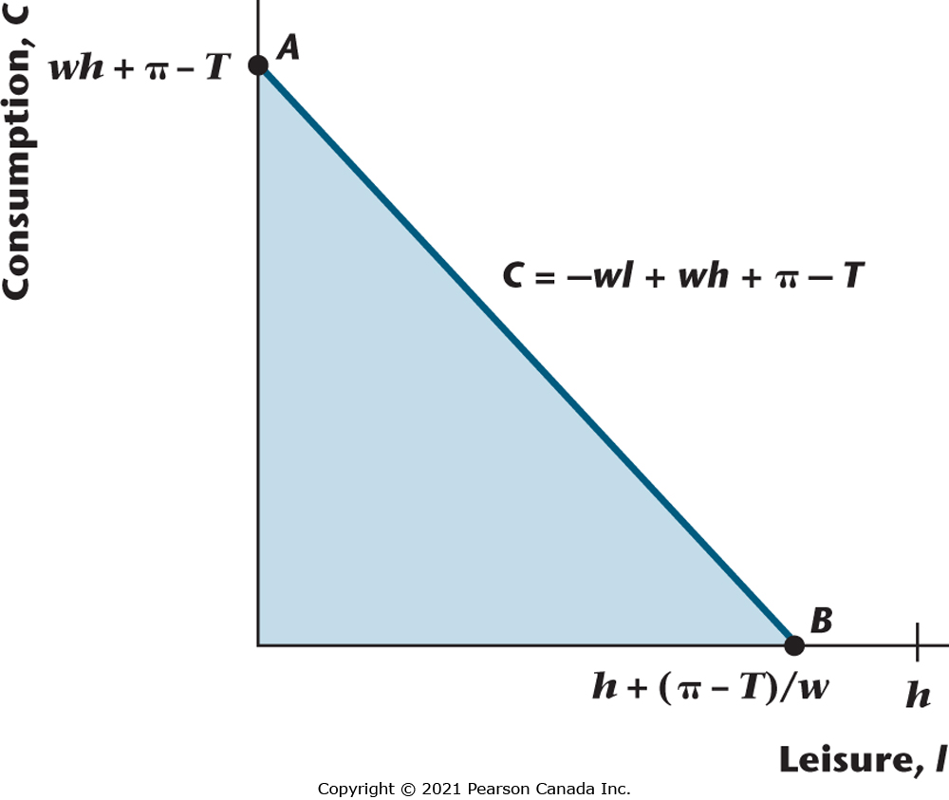
Figure 4.3 Representative Consumer’s Budget Constraint T > π
The figure shows the consumer’s budget constraint for the case where taxes are greater than the consumer’s dividend income. The slope of the budget constraint is −w, and the constraint shifts with the quantity of nonwage real disposable income, π - T. All points in the shaded area and on the budget constraint can be purchased by the consumer.

Slide 13
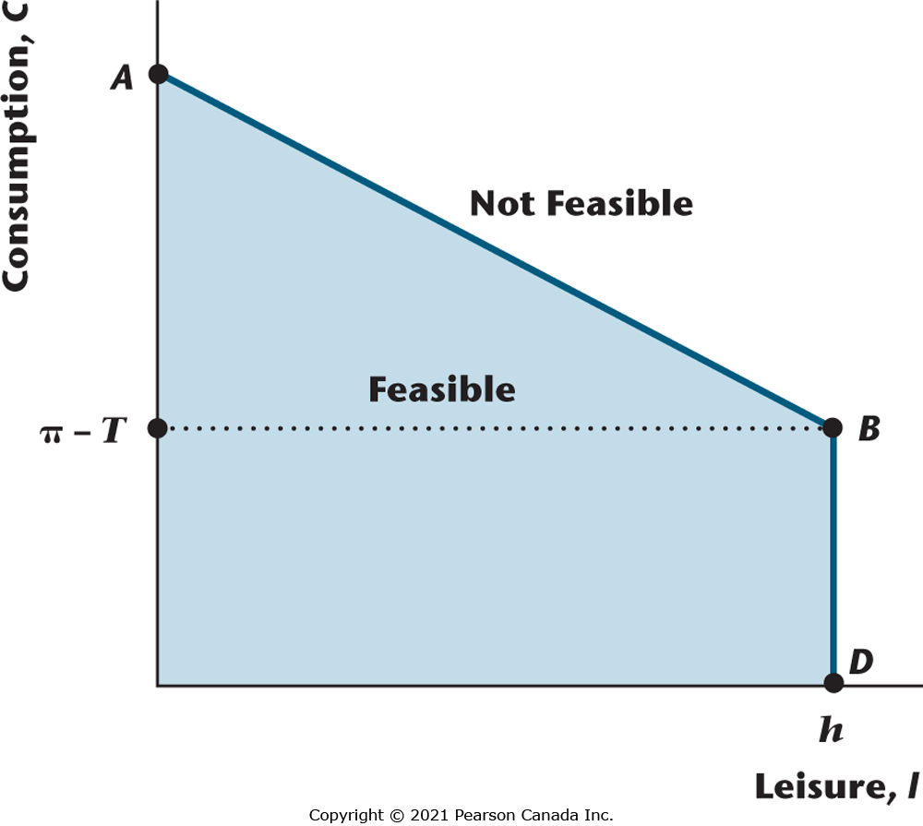
Figure 4.4 Representative Consumer’s Budget Constraint T < π
The figure shows the consumer’s budget constraint when taxes are less than dividend income. This implies that the budget constraint is kinked. The examples we study will always deal with this case, rather than the one where taxes are greater than dividend income. Consumption bundles in the shaded region and on the budget constraint are feasible for the consumer; all other consumption bundles are not feasible.

Slide 14
Consumer Optimization
The consumer chooses the consumption bundle that is on his or her highest indifference curve, while satisfying his or her budget constraint.

Slide 15
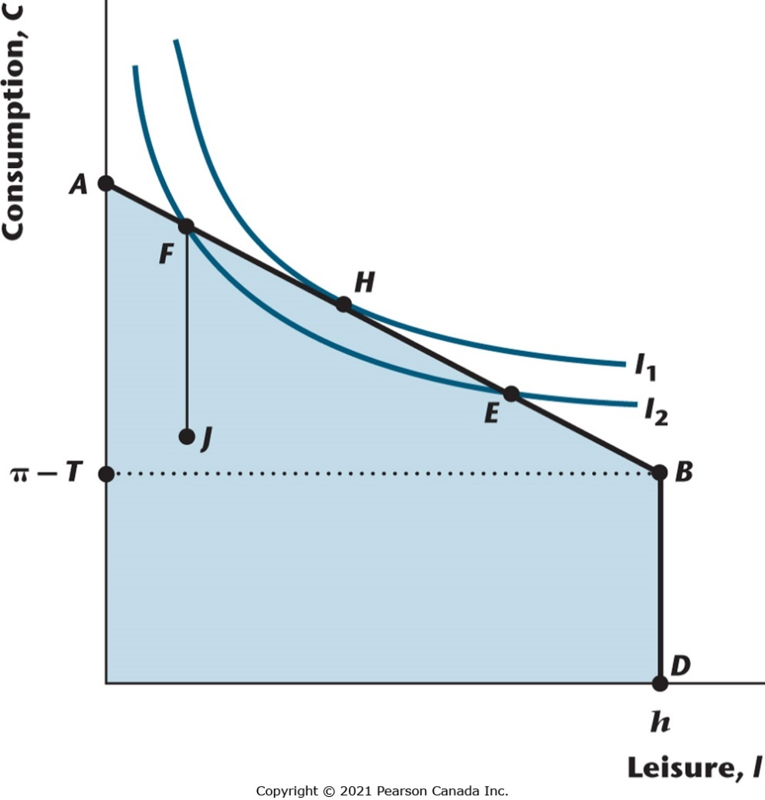
Figure 4.5 Consumer Optimization
The consumption bundle represented by point H, where an indifference curve is tangent to the budget constraint, is the optimal consumption bundle for the consumer. Points inside the budget constraint, such as J, cannot be optimal (more is preferred to less), and such points as E and F, where an indifference curve cuts the budget constraint, also cannot be optimal.

Slide 16
Optimization Implies:
The marginal rate of substitution of leisure for consumption equals the real wage.

Slide 17
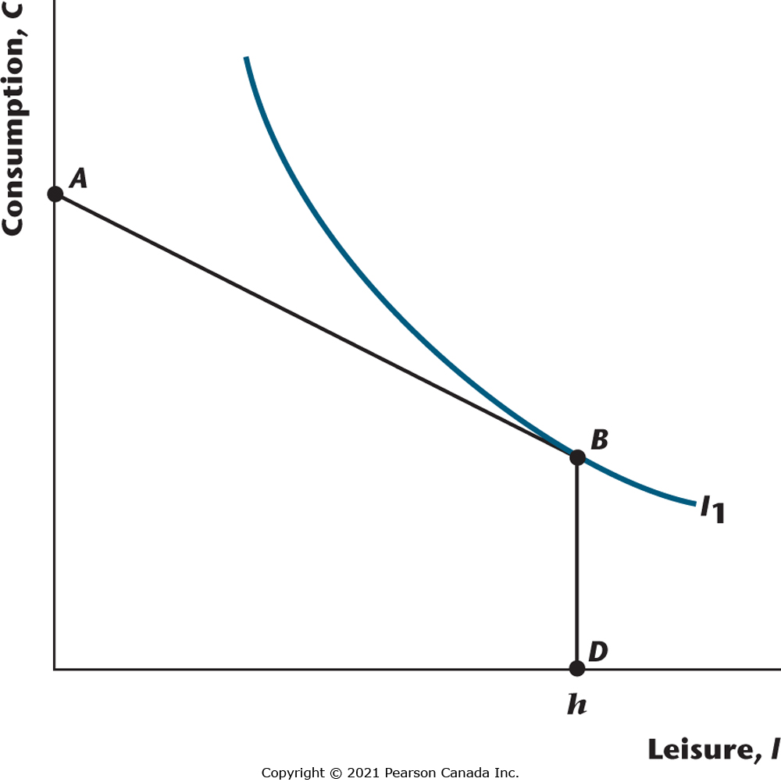
Figure 4.6 The Representative Consumer Chooses Not to Work
The consumer’s optimal consumption bundle is at the kink in the budget constraint, at B, so that the consumer does not work (l = h). This is a situation that cannot happen, taking into account consistency between the actions of the consumer and of firms.

Slide 18
Real Dividends or Taxes Change for the Consumer
Assume that consumption and leisure are both normal goods.
An increase in dividends or a decrease in taxes will then cause the consumer to increase consumption and reduce the quantity of labour supplied (increase leisure).

Slide 19
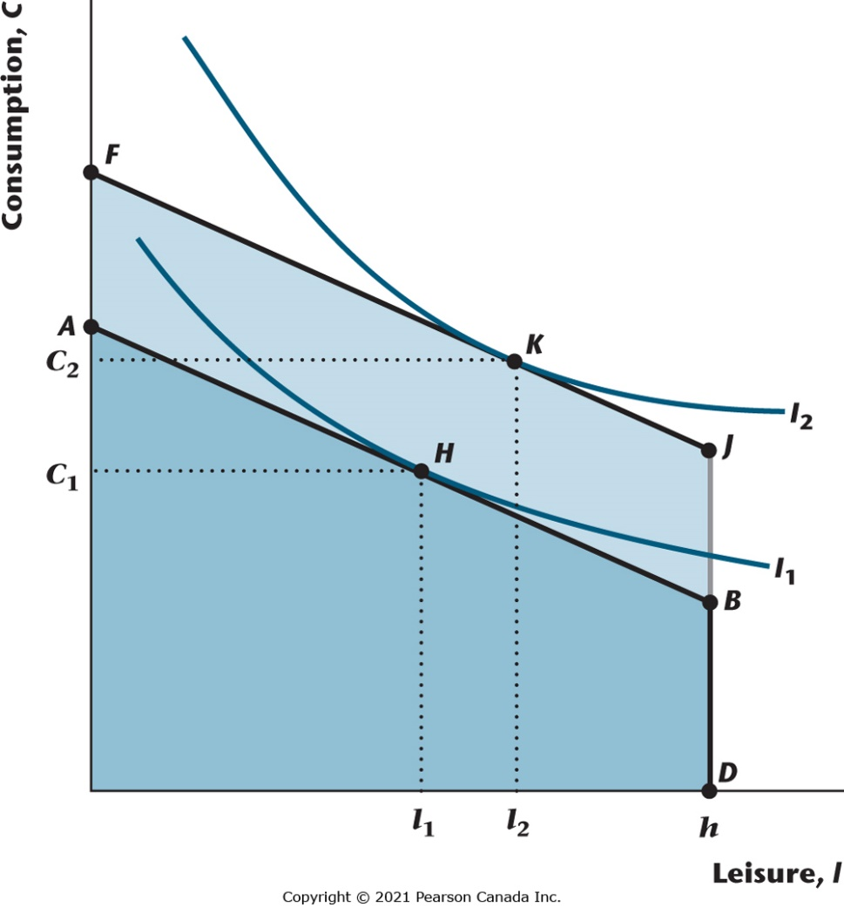
Figure 4.7 An Increase in the Consumer’s Dividend Income
Initially the consumer chooses H, and when dividend income rises (or taxes fall), this shifts the budget constraint out in a parallel fashion (the real wage, which determines the slope of the budget constraint, stays constant). Consumption and leisure both increase, as both are normal goods.

Slide 20
An Increase in the Market Real Wage Rate
This has income and substitution effects.
Substitution effect: the price of leisure rises, so the consumer substitutes from leisure to consumption.
Income effect: the consumer is effectively more wealthy and, since both goods are normal, consumption increases and leisure increases.
Conclusion: Consumption must rise, but leisure may rise or fall.

Slide 21
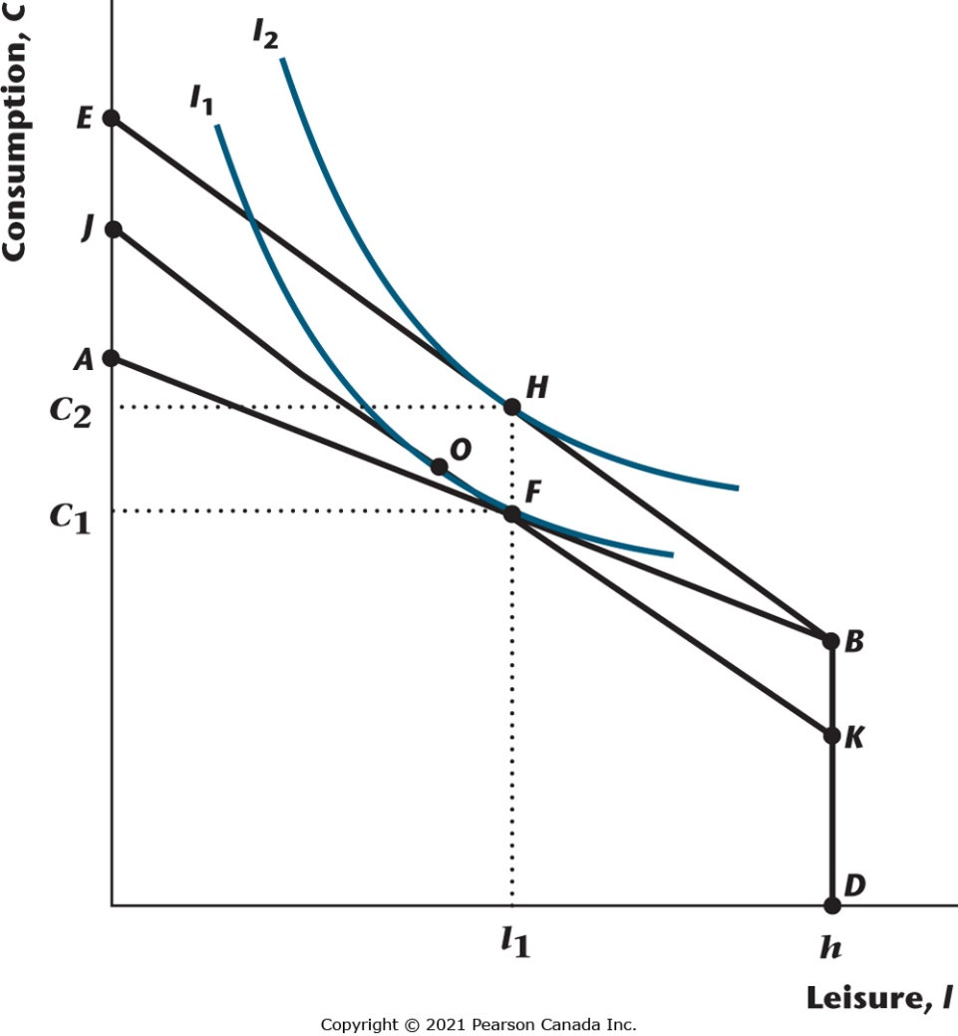
Figure 4.8 Increase in the Real Wage Rate–Income and Substitution Effects
An increase in the real wage shifts the budget constraint from ABD to EBD. The kink in the constraint remains fixed, and the budget constraint becomes steeper. Consumption must increase but leisure may rise or fall because of opposing substitution and income effects. The substitution effect is the movement from F to O; the income effect is the movement from O to H.

Slide 22

Figure 4.10 Labour Supply Curve
The labour supply curve tells us how much labour the consumer wants to supply for each possible value for the real wage. Here, the labour supply curve is upward-sloping, which implies that the substitution effect of an increase in the real wage is larger than the income effect for the consumer.

Slide 23

Figure 4.11 Effect of an Increase in Dividend Income or a Decrease in Taxes
The labour supply curve shifts to the left when dividend income increases or taxes fall because of a positive income effect on leisure for the consumer.

Slide 24
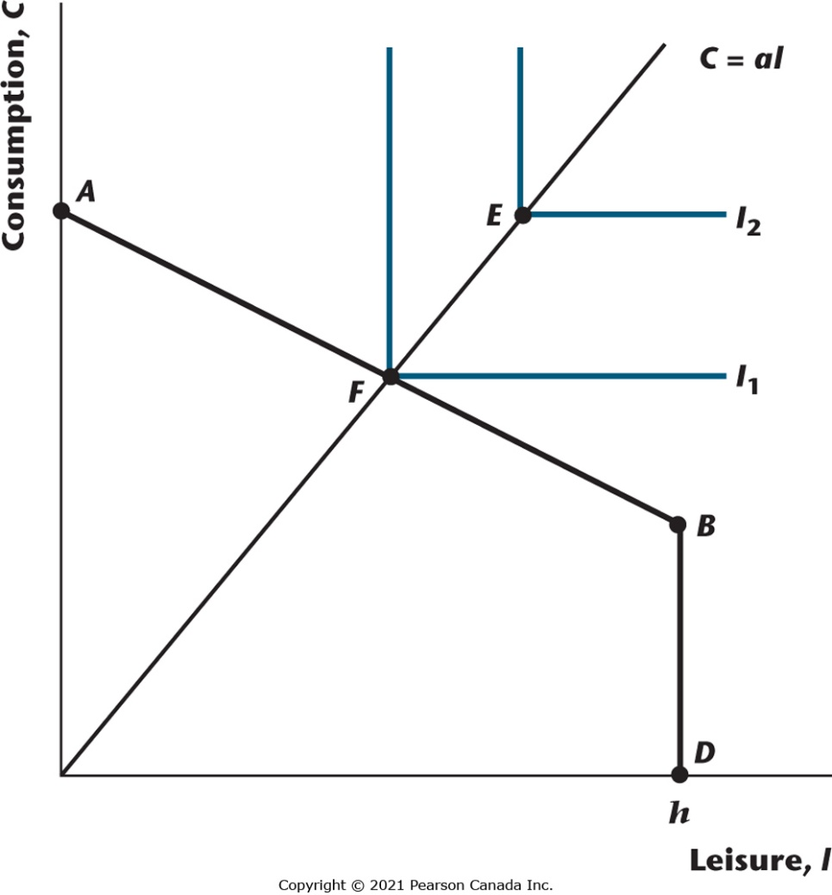
Figure 4.12 Perfect Complements
When consumption and leisure are perfect complements for the consumer, indifference curves are L-shaped with right angles along the line C = al, where a is a constant. The budget constraint is ABD, and the optimal consumption bundle will always be on the line C = al.

Slide 25
The Representative Firm
The production function.
Profit maximization and labour demand.

Slide 26
The Firm’s Production Function

Slide 27
Properties of the Firm’s Production Function
Constant returns to scale.
Output increases with increases in either the labour input or the capital input.
The marginal product of labour decreases as the labour input increases.
The marginal product of capital decreases as the capital input increases.
The marginal product of labour increases as the quantity of the capital input increases.

Slide 28
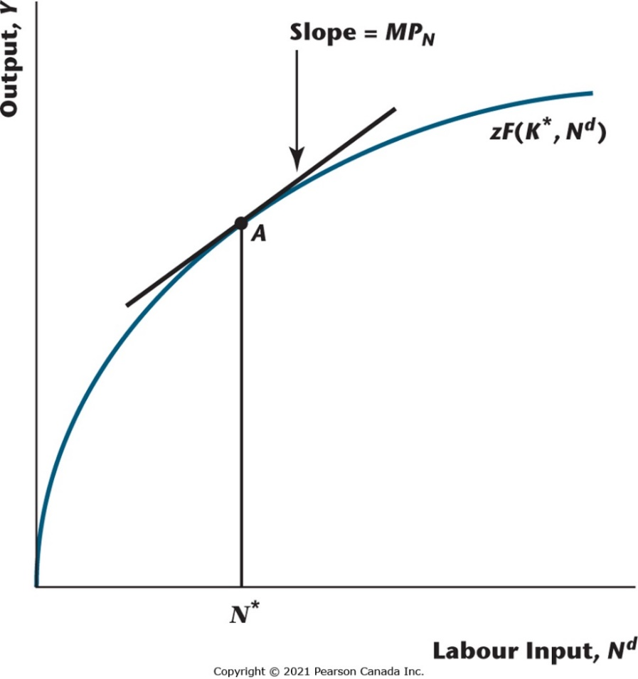
Figure 4.13 Production Function, Fixing the Quantity of Capital, and Varying the Quantity of Labour
The marginal product of labour is the slope of the production function at a given point. Note that the marginal product of labour declines with the quantity of labour.

Slide 29
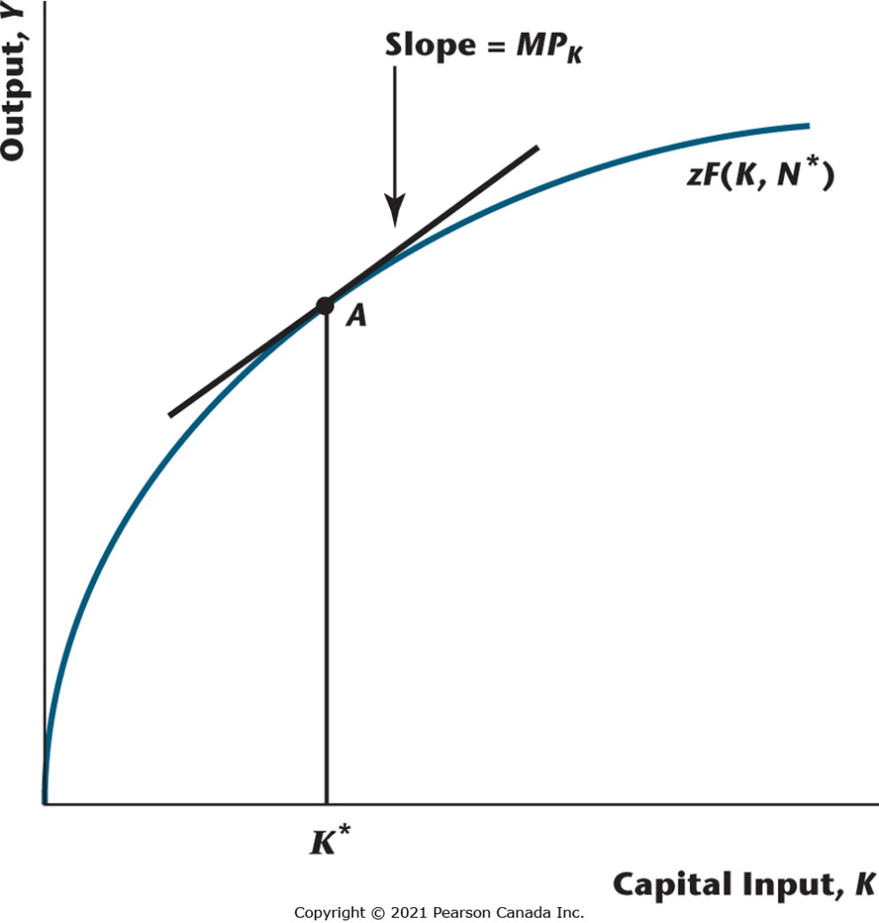
Figure 4.14 Production Function, Fixing the Quantity of Labour, and Varying the Quantity of Capital
The slope of the production function is the marginal product of capital, and the marginal product of capital declines with the quantity of capital.

Slide 30
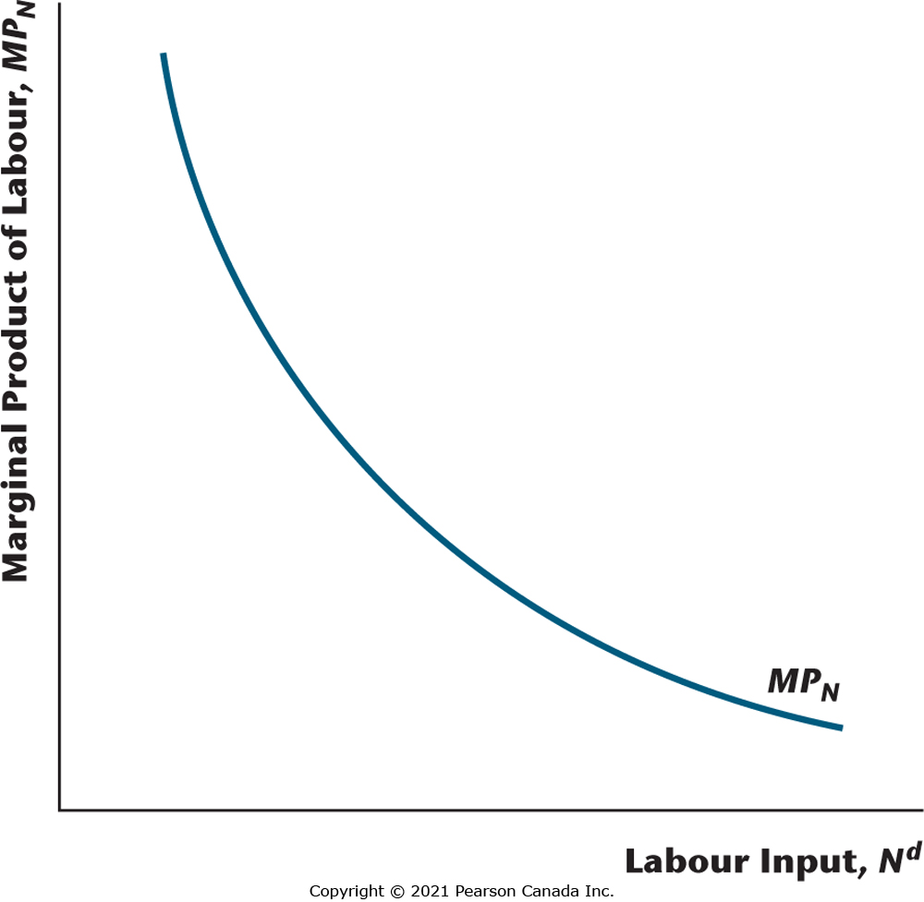
Figure 4.15 Marginal Product of Labour Schedule for the Representative Firm
The marginal product of labour declines as the quantity of labour used in the production process increases.

Slide 31
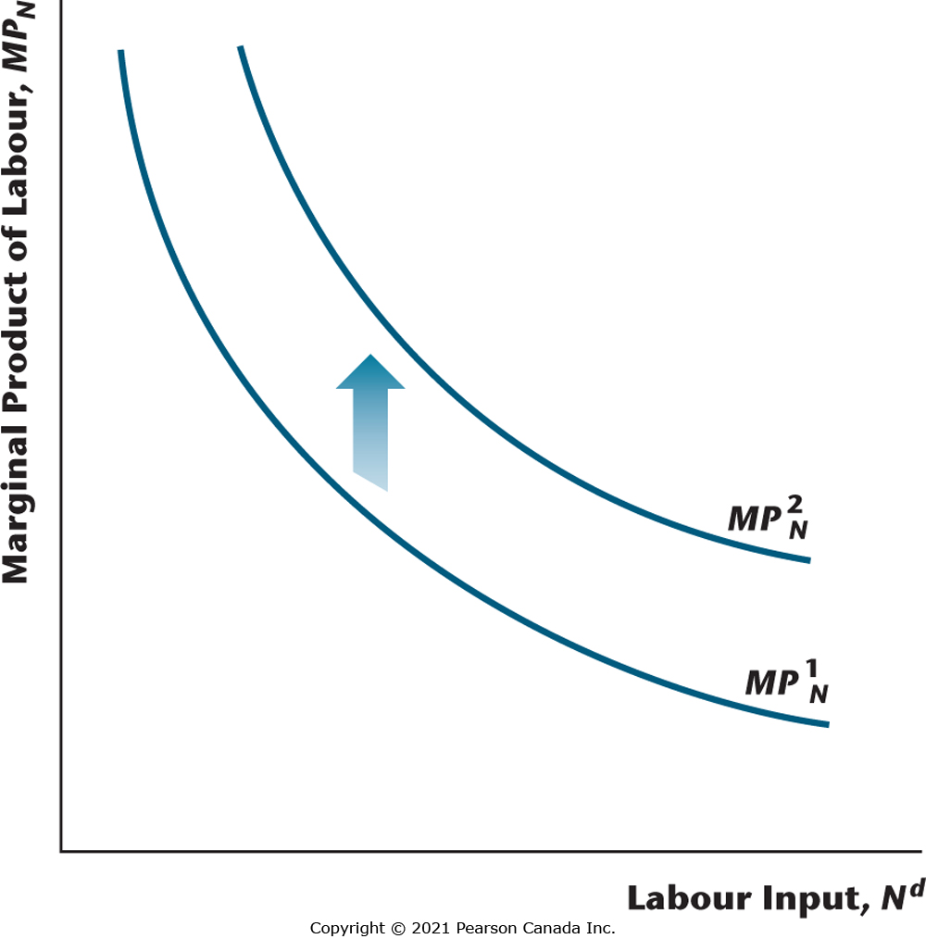
Figure 4.16 Adding Capital Increases the Marginal Product of Labour
For each quantity of the labour input, the marginal product of labour increases when the quantity of capital used in production increases.

Slide 32
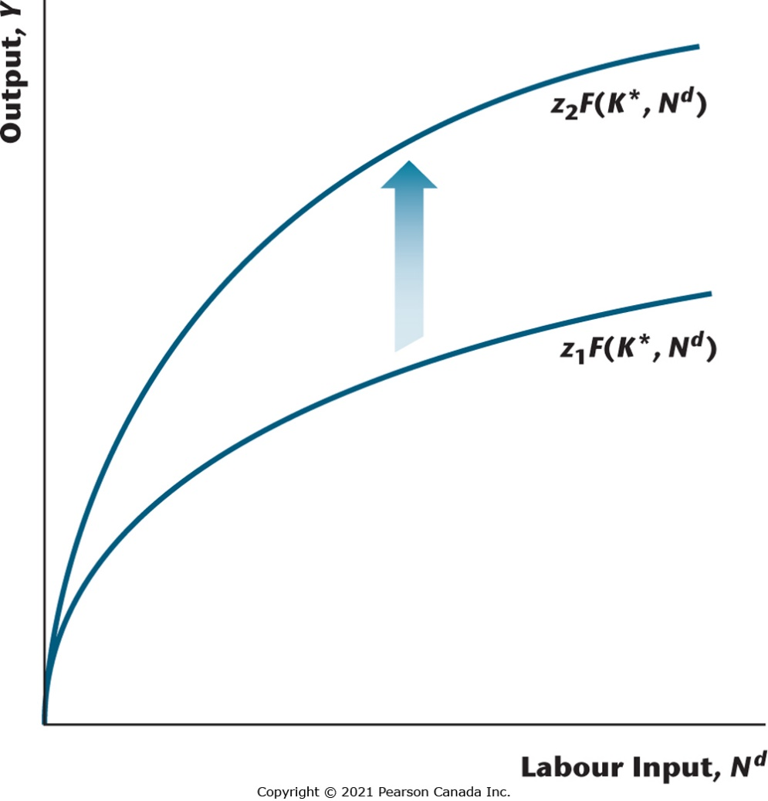
Figure 4.17 Total Factor Productivity Increases
An increase in total factor productivity has two effects: More output is produced given each quantity of the labour input, and the marginal product of labour increases for each quantity of the labour input.

Slide 33
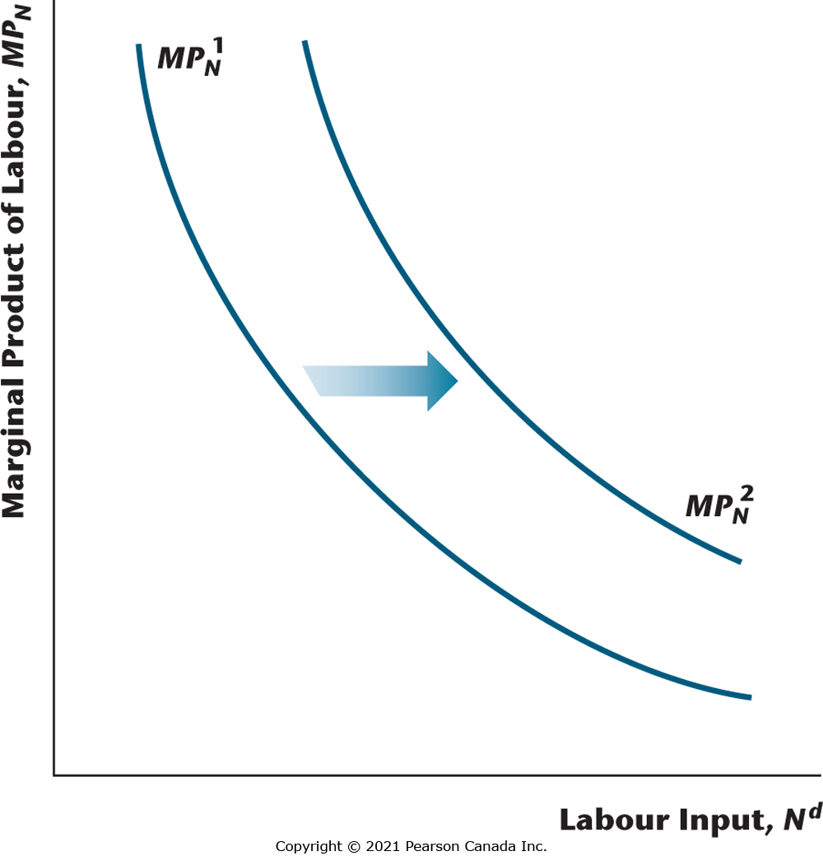
Figure 4.18 Effect of an Increase in Total Factor Productivity on the Marginal Product of Labour
When total factor productivity increases, the marginal product of labour schedule shifts to the right.

Slide 34
Profit Maximization
When the firm maximizes profits, the marginal product of labour equals the real wage.

Slide 35

Figure 4.19 The Solow Residual for Canada, 1961–2017
The Solow residual is a measure of total factor productivity, and it is calculated here by using a Cobb–Douglas production function. Measured total factor productivity has increased over time, and it also fluctuates about trend, as shown.

Slide 36
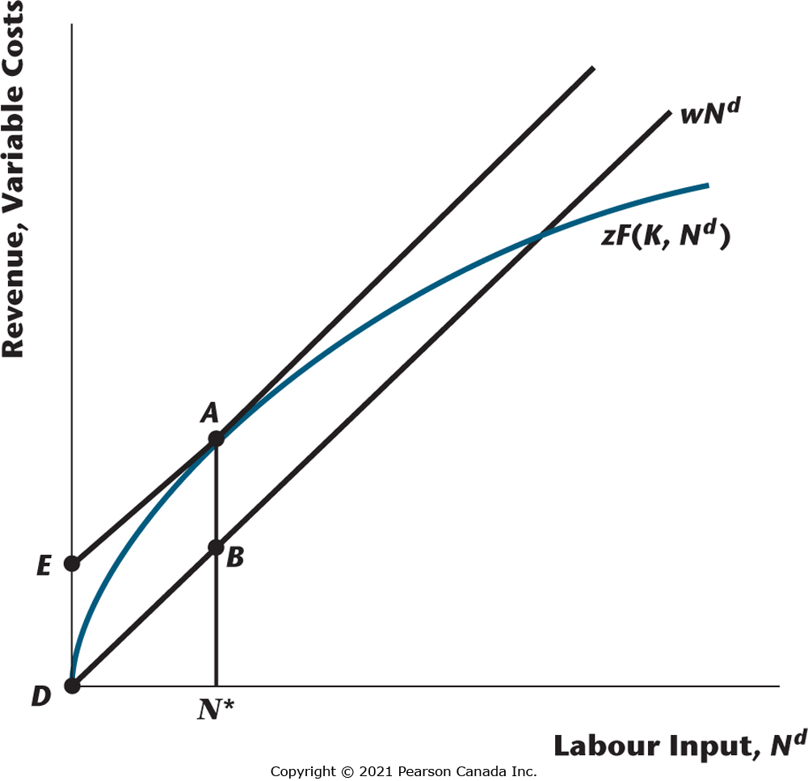
Figure 4.20 Revenue, Variable Costs, and Profit Maximization
Y = zF (K, N^{d}) is the firm’s revenue, while wN^{d} is the firm’s variable cost. Profits are the difference between the former and the latter. The firm maximizes profits at the point where marginal revenue equals marginal cost, or MP_{N} = w. Maximized profits are the distance AB, or the distance ED.

Slide 37
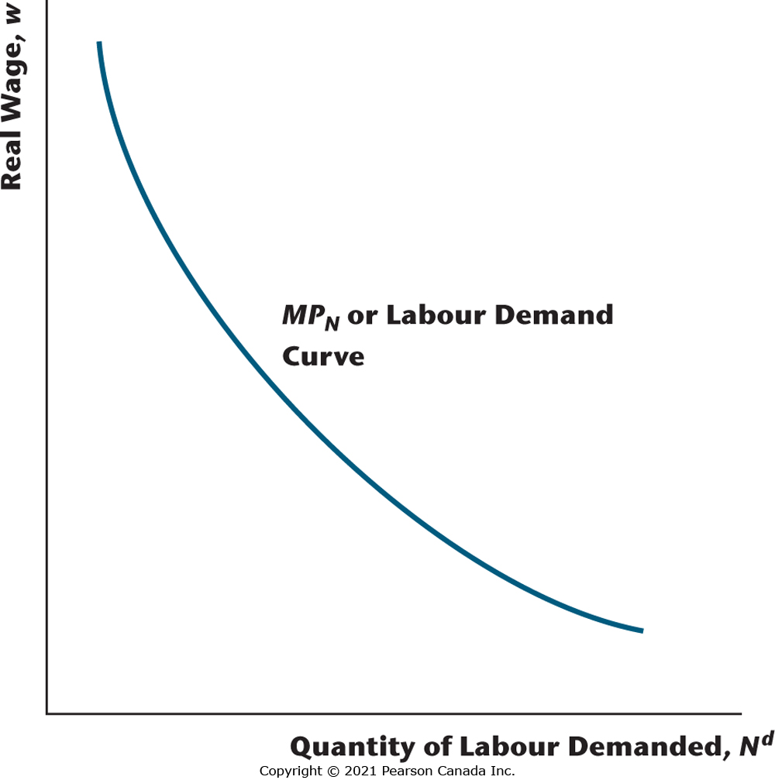
Figure 4.21 The Marginal Product of Labour Curve Is the Labour Demand Curve of the Profit-Maximizing Firm
This is true because the firm hires labour up to the point where MP_{N} = w.

